Slide 1
Course No:CSE 4110
Presented by:
Taslima Akter Joty
Roll:1807046
Sumaiya Akter Mifra Roll:1807057

Slide 2
Connect 4

Slide 3
Outlines
Introduction
Process of the Game
Algorithms

Slide 4
Introduction
This is a board game
There is a seven column, six-row vertically suspended grid
Two players can play this game
Here one player is human and another player is AI
In this game the players choose a color and then take turns dropping colored tokens into the grid
Player who matches four same consecutive colors win the game

Slide 5

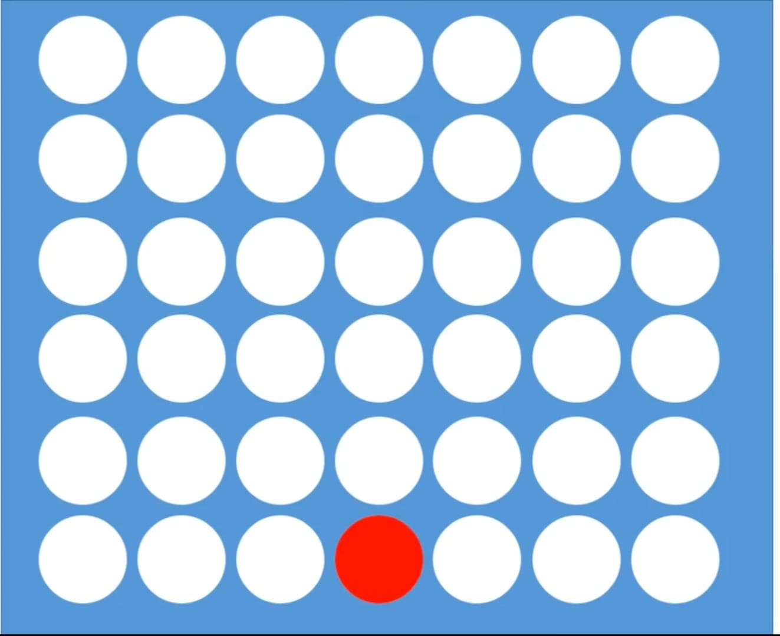
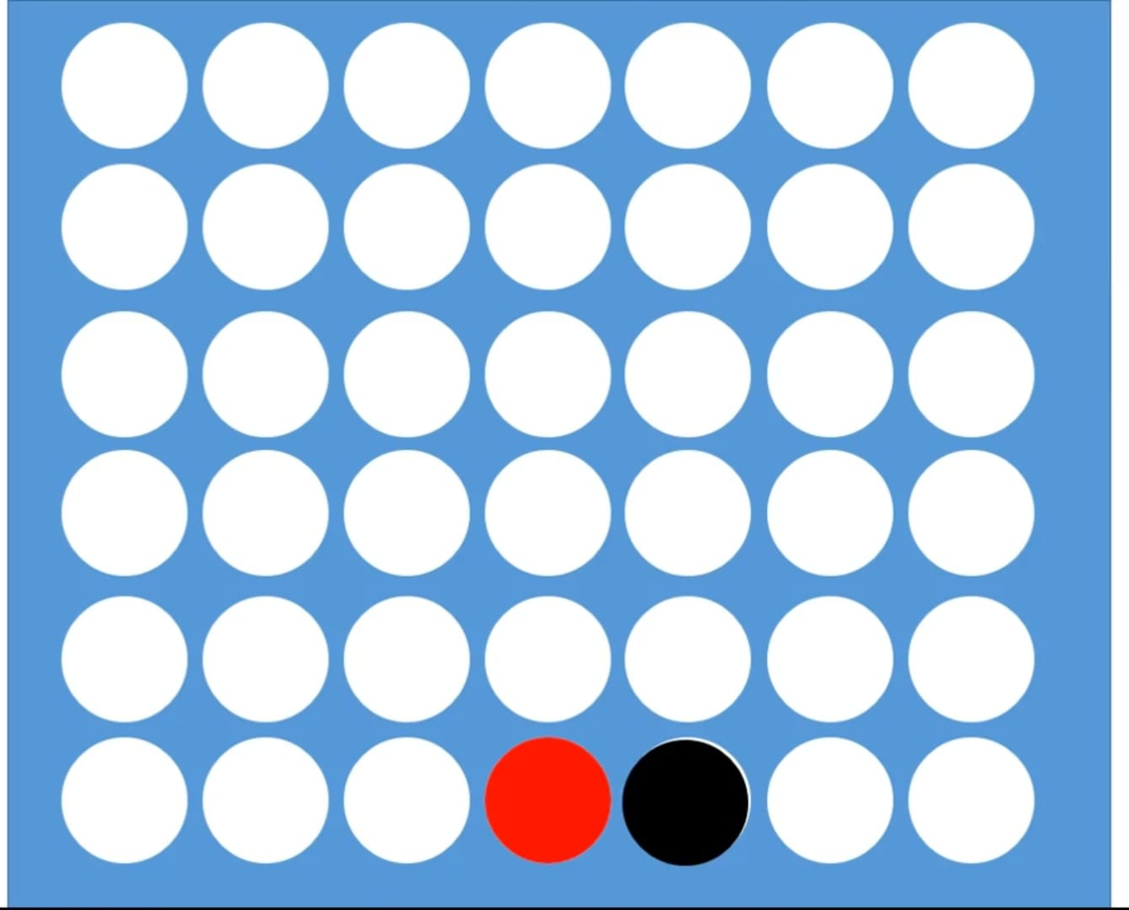
Process of the Game
A simple procedure is given below
Step 1: An empty grid
Step 2: First turn for red
Step 3: Second turn for black

Slide 6
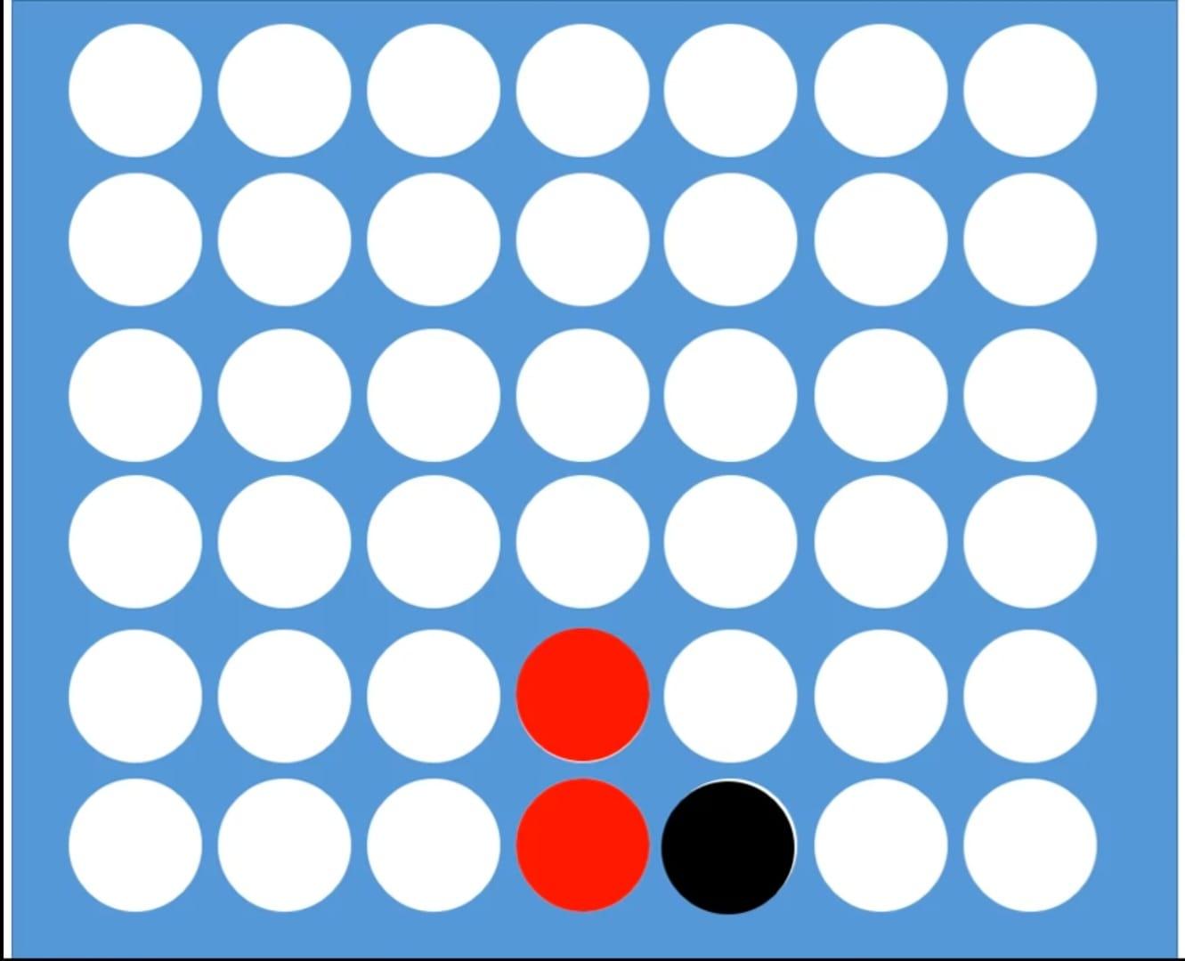
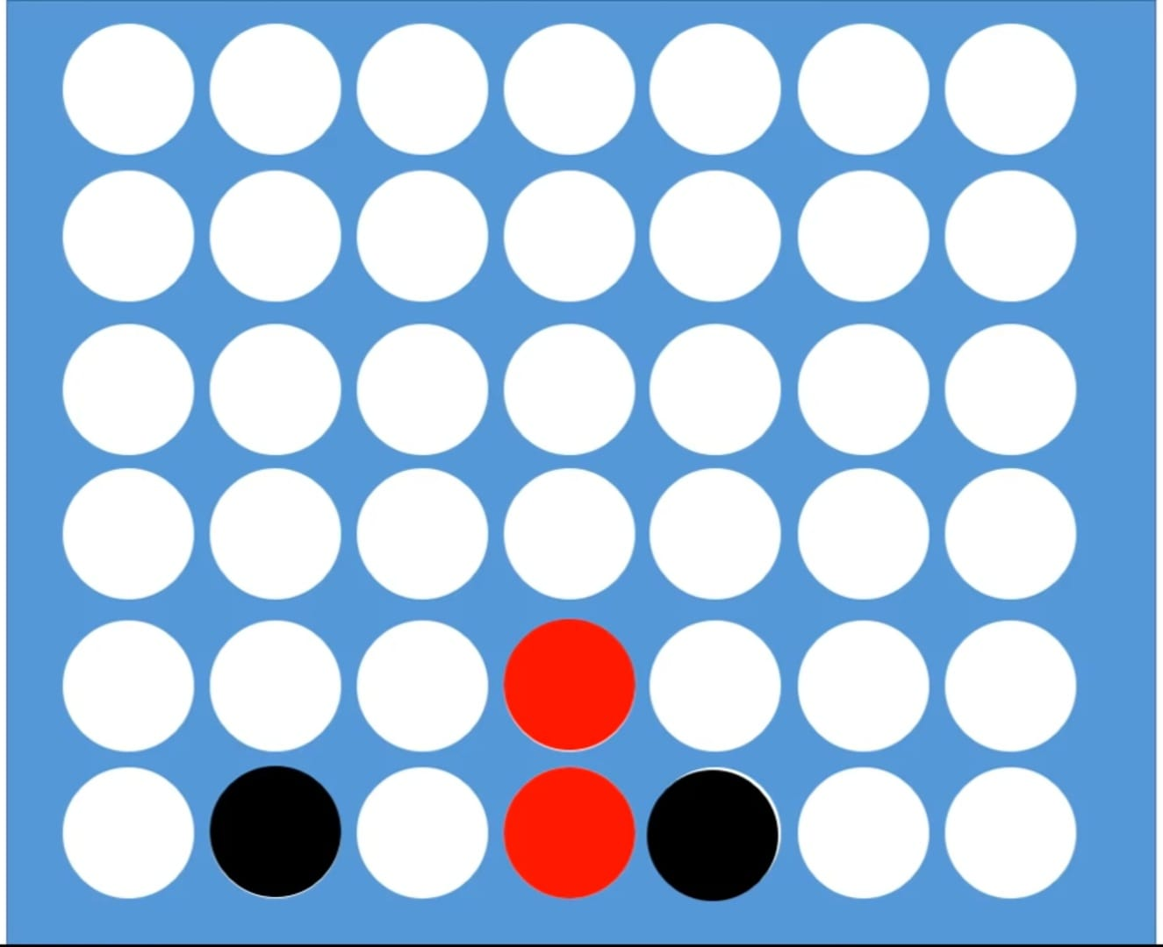
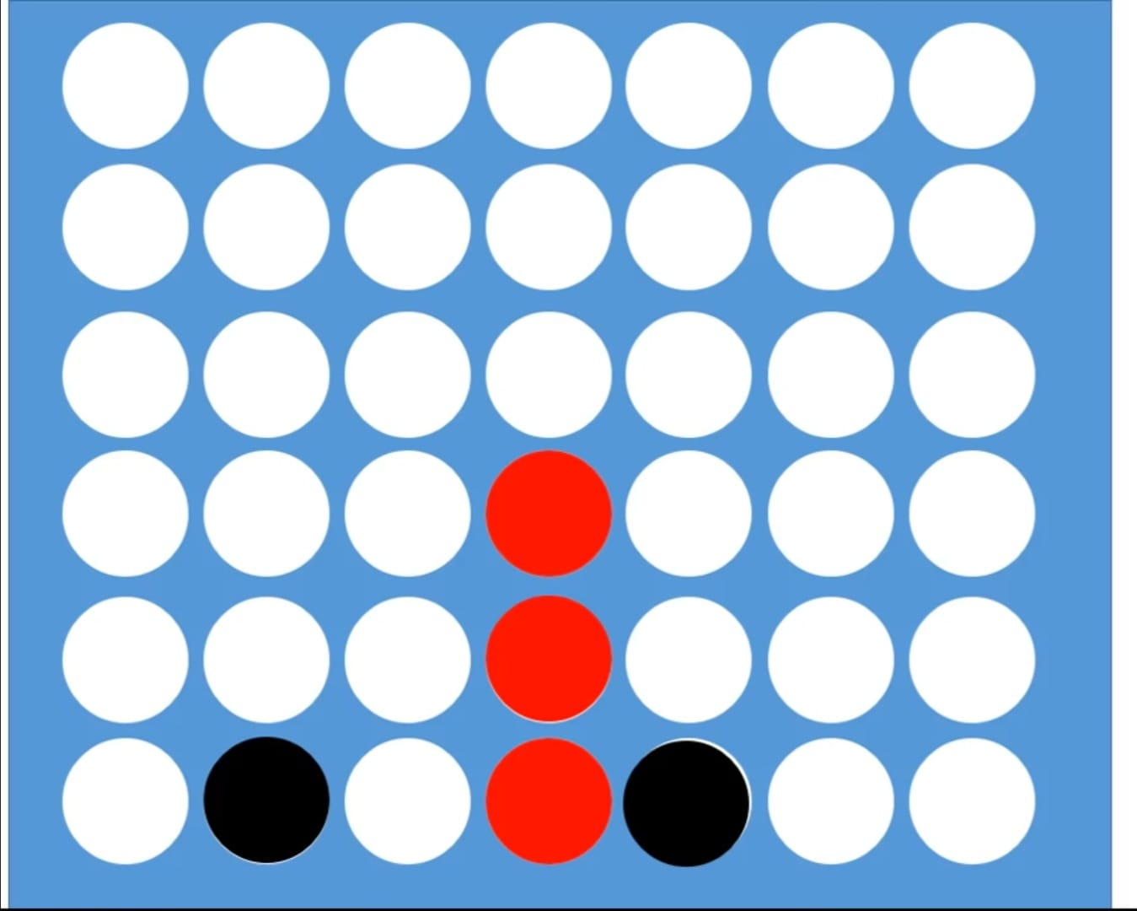
Process of the Game (cntd..)
Step 4: Third turn for red
Step 5: Forth turn for black
Step 6: Fifth turn for red

Slide 7
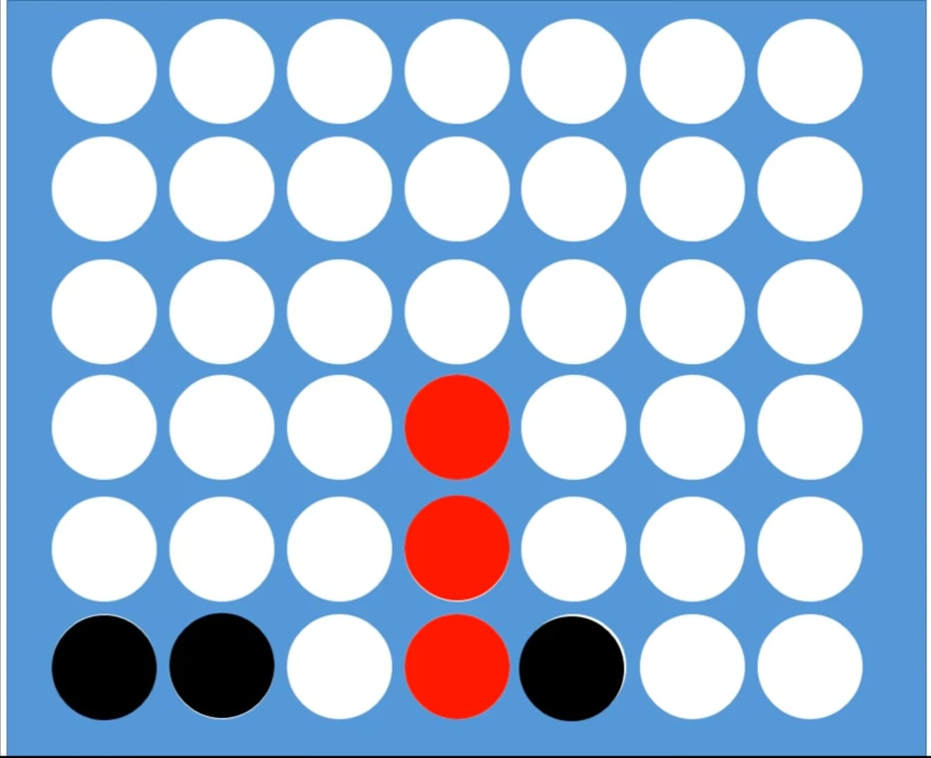
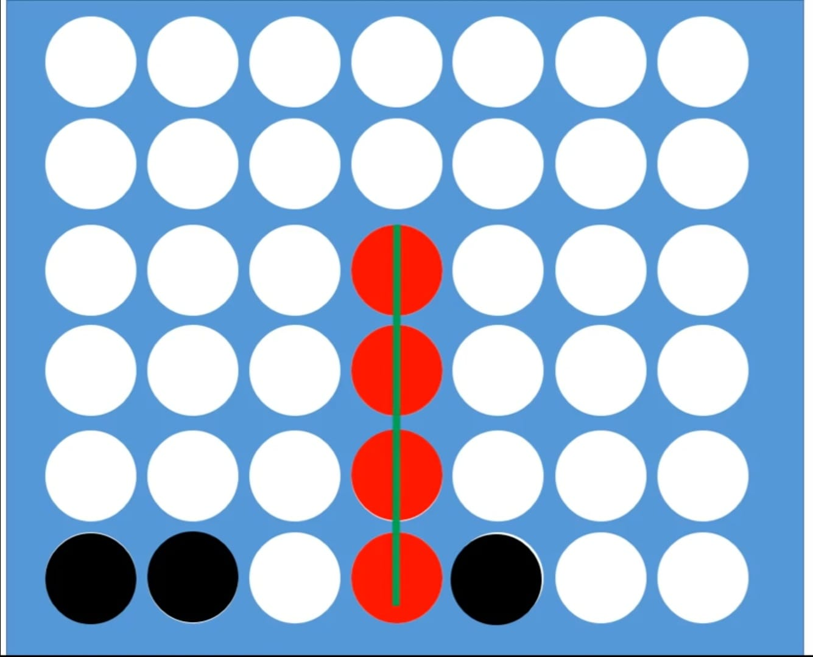
Process of the Game (cntd..)
Red wins here!!
Step 7: Sixth turn for black
Step 8: Seventh turn for black

Slide 8
Algorithms
Connect 4 is a perfect example of a game where the Minimax algorithm can be applied
The Minimax algorithm is a decision-making algorithm that is commonly used in two-player games to determine the best possible move for a player to make
In Connect 4, the algorithm can be applied as follows:
Generate a game tree that represents all possible future moves that can be made by both players

Slide 9
Algorithms (cntd..)
Starting at the current state of the game, evaluate all possible moves that the current player can make
For each possible move, assume that the opponent will make the best possible move for them
Evaluate the resulting state of the game and assign a score to it based on the likelihood of winning for the current player
Repeat this process for all possible moves that the current player can make
Choose the move that leads to the highest score
Repeat this process until the game is over

Slide 10


